Slide 1
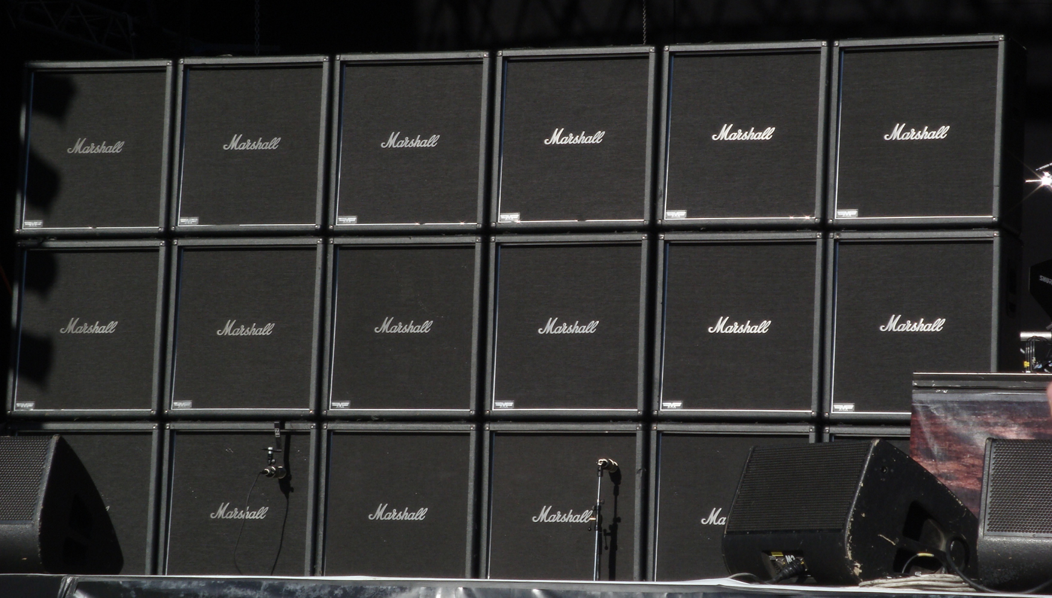
Electric Guitar Amplifiers
Tube and transistor amplifiers
Tuesday, November 16th, 2010
Ryan Anderson, Eli Atkins, Tyler Johnson
http://upload.wikimedia.org/wikipedia/commons/e/eb/MarshallStack_Slayer.jpg

Slide 2
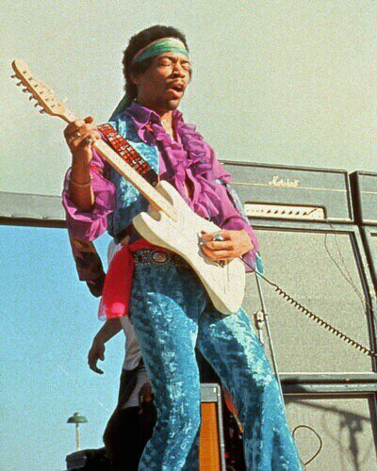
Overview
Tube amplifier
Developed in 1930’s
Accepted original sound
Still used today
Transistor amplifier
Developed in 1970’s
Widespread use
Still improving
http://www.stratocaster.name/JImi%20Hendrix.jpg

Slide 3
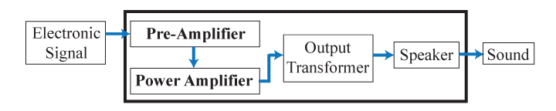
General Guitar Amplifier Design
Sound expressed as electronic signal
Signal amplified twice in two stages
Tube or transistor amplifying components
Output transformer makes speaker useable for amplifier
Typical gain:
3 mV to 30 V = 10,000 times greater

Slide 4
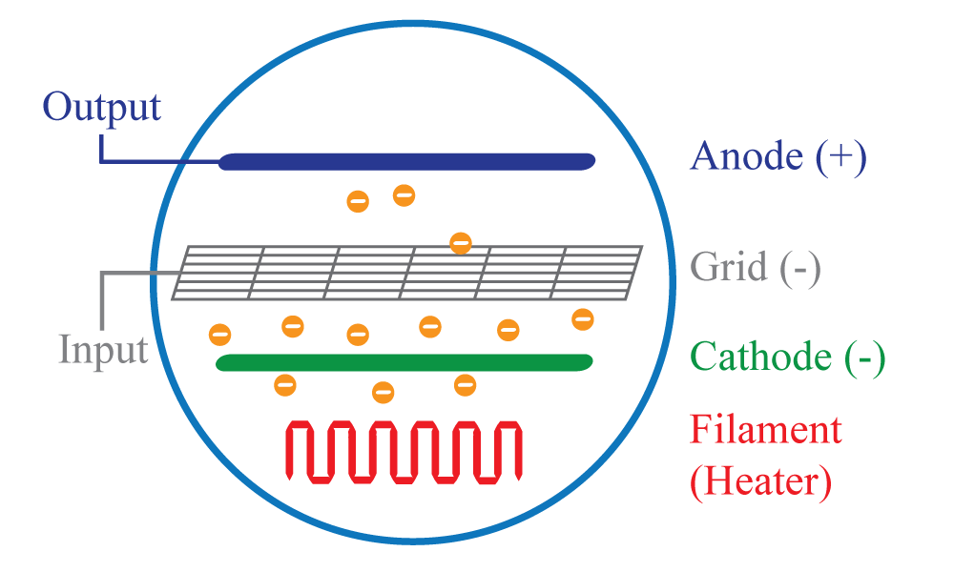
Tube Amplifier
Large voltage between anode and cathode
Hot filament drives electrons off cathode
Small grid charge controls large output current

Slide 5
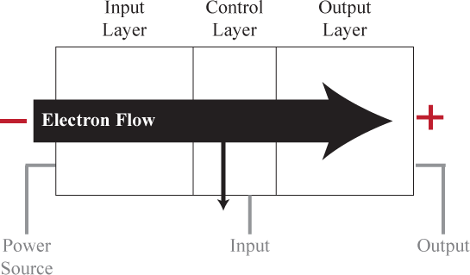
Transistor Amplifier
Three semiconductor layers
Small input current controls large electron flow

Slide 6
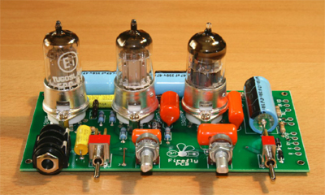
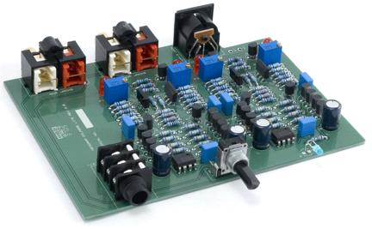
Comparison
 | Tube | Transistor
Sound | Warm and natural, desirable distortion, best at high volumes | Very precise, processed, quick response, sometimes unnatural
Size | Bulky, heavy | More compact
Cost | Expensive | More affordable
Maintenance | Fragile, regular tube replacement/tuning | Little required, more durable
http://www.jedistar.com/images/amp/firefly_amp.jpg
http://bassmiddletreble.files.wordpress.com/2008/04/clip_image010_000.jpg

Slide 7
Wrap-up
Tubes:
- Respected sound
- Continues to be used today
Solid-state:
- Well-known technology in other fields
- Sound continuing to develop
Choice depends on user’s preferences and priorities

Slide 8
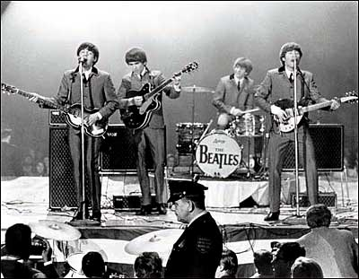
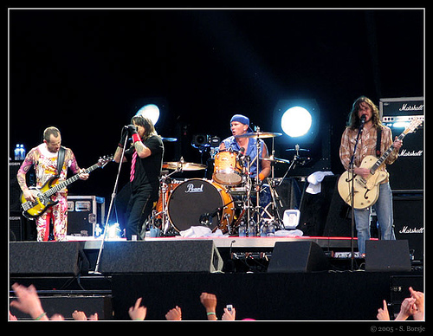
Questions?
http://thebeatlesfanclub.webs.com/beatles_concert.jpg
http://www.last.fm/music/Red+Hot+Chili+Peppers/+images/131387

